Slide 1
Week 1 – Topics
Tools Installation & Setup
Java
Eclipse
Git & GitHub
What is Programming?
Java Intro
Basic Programs
Variables & Data Types
Operations
Command Line Interface (CLI)
Source Control
Git / GitHub

Slide 2
What is Programming?

Slide 3
What is Programming?
The definition of Computer Programming in the simplest form is the process of preparing a program to complete tasks on a computer
Programming is writing instructions to tell a computer how to move, manipulate and display data in an automated fashion
The goal is to break down a problem into smaller pieces to instruct a computer how to do each task:
The computer would need to have a place to store & manipulate its data (variables)
The computer would need to know what we want it to do (tasks, methods)
The computer would have to be taught how to accomplish those tasks (operations)
Content Link in LMS

Slide 4
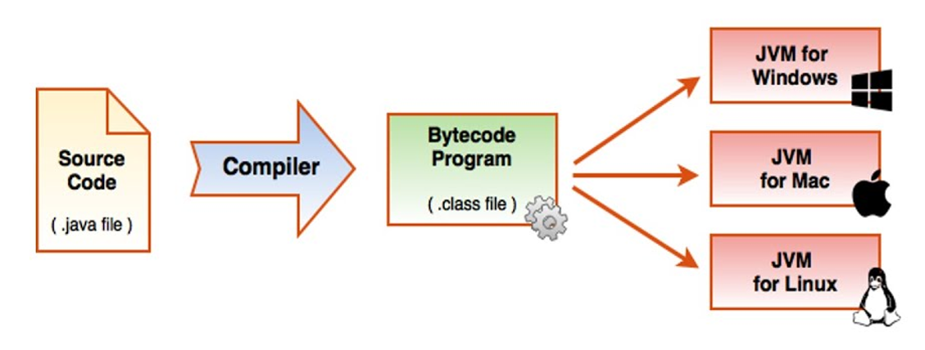
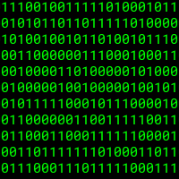
Why (and how) do we write programs?
Computers think and understand Binary (1’s and 0’s)…period!
We use programming languages like Java to write instructions in human readable/understandable code that becomes binary executable code that is run on a computer

Slide 5
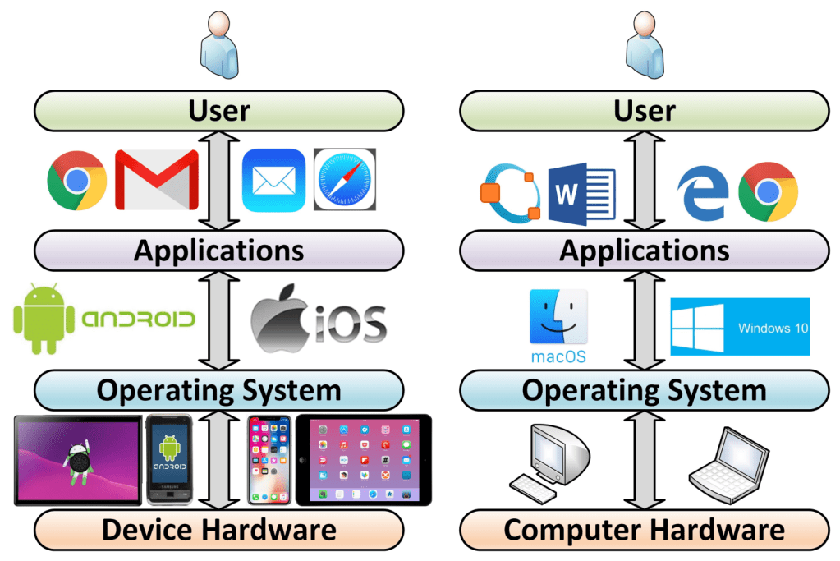
The Technology Layer Cake: Users, Applications (Software), Operating System, Hardware
Your
Software

Slide 6
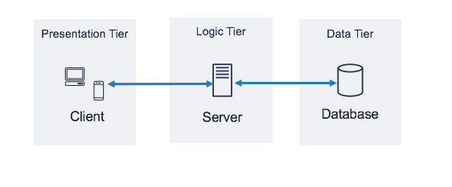

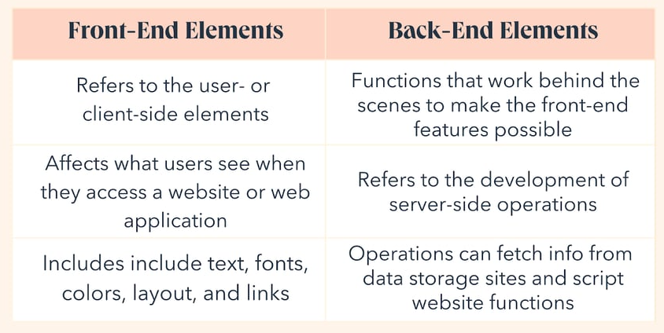
Front-End vs Back-End Development
Front-End
Development
Back-End Development

Slide 7
Steps to Programming
Decide how to solve a task or request (Design) -- remember to break the task into smaller pieces to be solved
Write the code to solve the task by first writing code to solve each smaller piece of the solution
Compile and/or Run the program that has been written.
Test and Debug the program
Test: Make sure the code works as designed.
Debug: Track Down and Fix any flaws in the code that you wrote.
Document exactly what has been coded and how it works.
Content Link in LMS

Slide 8
Java Introduction

Slide 9
Overview of Java
Java is the computer programming language that we are going to be using throughout this course.
Java was created at Sun Microsystems, Inc. with James Gosling as the lead architect, first released in 1995, and brought something new to the programming world. The Java implementation minimizes dependencies, and is platform independent and portable.
The Java compiler (javac) compiles Java source code, and converts that code into bytecode, which is executed by the JVM (Java Virtual Machine). The JVM transforms the bytecode into machine-readable code.
The two-step compilation process is how platform independence leading to portability is accomplished -- one of Java's greatest features.
platform independence: A Java program that is compiled on one machine can be executed on any other machine, regardless of the Operating System, as long as the target machine has a JVM installed.
portability: a program (set of code) will run identically on different platforms, with no changes such as recompilation or rewriting source code.
Common Java Acronyms:
JDK -- the development platform -- Java Developer's Kit -- what you will install on your system.
JVM -- for runtime execution -- Java Virtual Machine -- provides a place for Java byte code to be executed.
JRE -- a software environment, which includes a set of tools used for Java application development, also referred to as the implementation of the JVM -- Java Runtime Environment

Slide 10
Java Tools / Environment Set-up
Installation of Java: We will be installing the current LTS of Java. Java has a number of Long Term Support versions of the language. The videos here speak of installing Java 8 (v1.8). Since Java 8 was released, there have only been two additional LTS releases of Java, including Java 11, and Java 17. At this point, you are welcome to install any of these LTS releases. In this course, we will be using the JDK, which is the Java Developers Kit. It is important to download the JDK of the Java Version that you choose. Download and install the Java JDK version of your choice, keeping in mind the LTS versions. Installation of Eclipse: We will also be installing an Integrated Development Environment or IDE. The IDE that we use in this course is Eclipse (for Java Developers). An IDE is a sophisticated text editor that has built-in knowledge of one or more programming languages. This is the location where we will be writing our code, in particular our Java code. After you download and install Eclipse (for Java Developers) following the Promineo Tech installation instructions, open the application. The first time that you open Eclipse, you will see a "Welcome" page. Feel free to read the information that is located there. For our purposes, we are going to exit out of that Welcome page, and you should see the standard Eclipse layout.

Slide 11
Java Tools / Environment Set-up
Installation of Java
Installation of Eclipse
TODO -> Java Project Set-up
Create a new Java Project
Create a new Java Package
Create a new Java Class → Basic Java first program
Content Link in LMS

Slide 12
Variables, Data Types, & Operations

Slide 13
Variables / Data Types
Since programming is defined as moving, manipulating, and displaying data, we need a way to know what data we are working with. We need a way to assign names to data. To do this, we use something called variables.
Variables can refer to different types of data. Variables are placeholders to hold our data. For example, alphanumeric/textual data or numeric data deals more with values and math.
Java is a statically typed programming language, which means that any variable must first be declared before it can be used.
To declare a variable, you must determine the variable's data type and name.
There are 8 primitive data types in Java:
byte - 8-bit integer, Range = -127 to 128 (1 = 01, 2 = 10, 3 = 11)
short - 16-bit integer, Range = -32,768 to 32,767
int - 32-bit integer, Range = -2³¹ to 2³¹-1
long - 64-bit integer, Range = -2⁶³ to 2⁶³-1
float - 32-bit floating point with a decimal
double - 64-bit floating point with a decimal
boolean - true/false
char - Single 16-bit character (e.g., ‘a’, ‘B’, ‘c’, ‘G’)
Additionally, there are predefined Object data types. Here is an example of one of those: String - textual data - "This is a string"
Content Link in LMS

Slide 14
Operations
Knowing that there are different types of data is great, but what is data good for if we don't use it in some way? For example, point of sales systems (the software used when we purchase something from a store, restaurant, etc) have to add up line items and then apply a tax to them.
That means we have to perform actions on data (addition and multiplication in this case). In programming, these actions are called operations.
An operation consists of one or more pieces of data, known as operands, and an operator, and performs a calculation or action on the operands thus resulting in a new value. One operator we are already familiar with is the assignment operator (the equals sign or =), which assigns the data on the right-hand side to the variable name/identifier on it's left.
Content Link in LMS

Slide 15
Command Line Interface

Slide 16
Command Line Interface (CLI) vs Graphical User Interface (GUI)
A Graphical User Interface or GUI is the visual representation of data that users interact with via mouse and keyboard. If we open a window or an application and there are buttons and text boxes, that is a GUI. Graphical User Interfaces or GUIs are great for displaying data in an extremely user-friendly manner, however, they are not always the quickest, most effective way to work with computers. Command Line Interfaces or CLIs are text-based tools that allow us to interact with a computer and data. Rather than visual elements, everything on a CLI is represented via plain text. Instead of clicking on different buttons to perform some sort of action, users type in text commands. This removes the need for a mouse and reduces the time spent to perform certain operations. Why do we care? Many programs used in software development only come as a Command Line Interface or CLI tool and have no Graphical User Interface or GUI version. There are many different CLIs, but the main two are Command Prompt (Windows) and Terminal (Mac and Linux). Note: We will discuss some basic commands to navigate the file system via CLI, but before we do, it is important to realize that what we see in the CLI is the same thing we see in the GUI. If we are in a folder (also known as a directory) in our GUI File Explorer and in our Command Prompt (Windows), or our GUI Finder and in our Terminal (Mac), we will see the same files in each, the GUI will display the files graphically, and the CLI will display the files textually.
Content Links in LMS

Slide 17
Source Control
Git and GitHub

Slide 18
Git and GitHub
git is a "distributed version control system designed to handle everything from small to very large projects with speed and efficiency". (git, Retrieved on 10/5/2022 from https://git-scm.com).
git is used in many software development environments, and provides a number of benefits for any software developer. It provides a backup of code that you are writing on your local system. In addition, when working on a project with a team, it provides a way to ensure everyone has the same, up-to-date code.
git is a Source Control tool used to enable teams to collaborate on projects at the same time. If users make changes to the same file that would overwrite one another, git provides merge conflict messages that enable users to manually adjust the multiple changes so that no one's code is overwritten. git also keeps track of all the changes made to a project by using save-points called commits.
GitHub is a web-based git GUI that enables us to visually manage our repositories and push our code to the cloud (GitHub servers).
Content Link in LMS
Free Book on Git https://git-scm.com/book/en/v2

Slide 19
Starting a New Project Repository in Git / GitHub
Starting a New Project Repo in Git / GitHub
Basic git Workflow
Uploading your Assignments to GitHub
Free Book on Git https://git-scm.com/book/en/v2
Content Link in LMS

Slide 20
Appendix

Slide 21
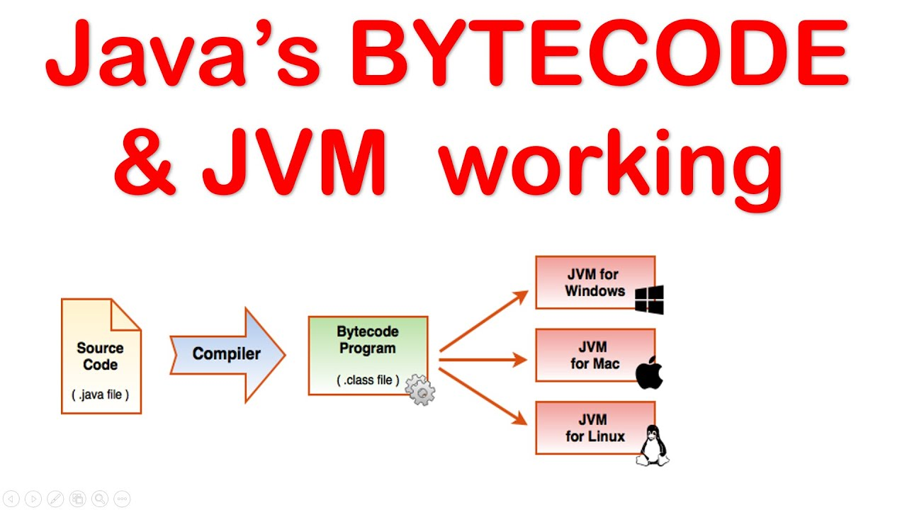
Java
Compile

Slide 22
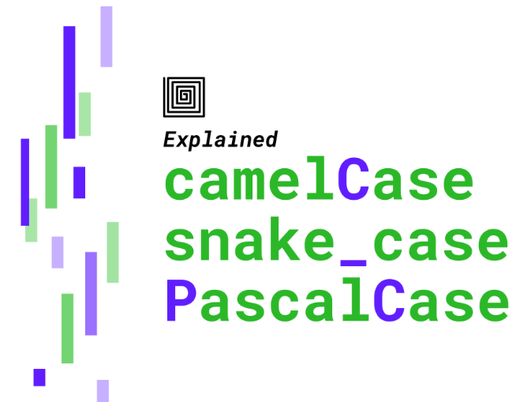
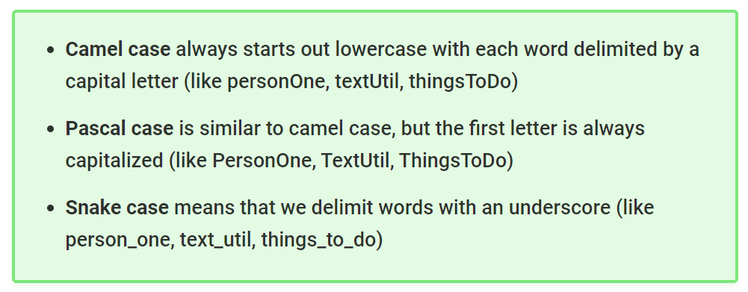
Java Naming Conventions / Standards
In Java:
Class names use PascalCase
Variable names & Method names use camelCase
We generally don’t use snake_case in Java

